Slide 1
Data Densification
Kris Erickson The Home Depot QuoteCenter

Slide 2
Background. Some Prior work.
High Density scatterplots in R. Hexbins
More Location data is available due to your phone. I downloaded OpenPaths and examined my own location data. Too much overplotting.
City of Boston Trash recycling by Allan Walker. Tableau Too much memory required!
Home Depot stores, much overlap at a national level. Large areas of the country with no stores.
An article by Steven Few called “Solutions to the Problem of Over-Plotting in Graphs”

Slide 3
Why is Data Densification important?
Data over plotting / overlap prevents the true picture from coming forth. Analysis is made harder by distorted or obscured information.
Excess number of points can slow the system down tremendously. Tableau has a maximum number of marks >1.6M.
Moving the work to the Data Engine rather than the VizQL visualization engine.
Able to answer generalized questions about an area not present in any single data point.

Slide 4
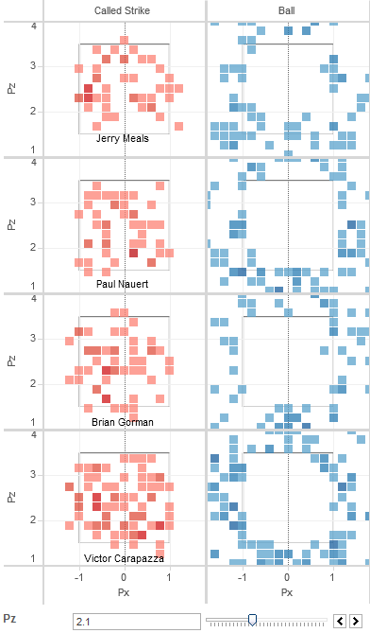
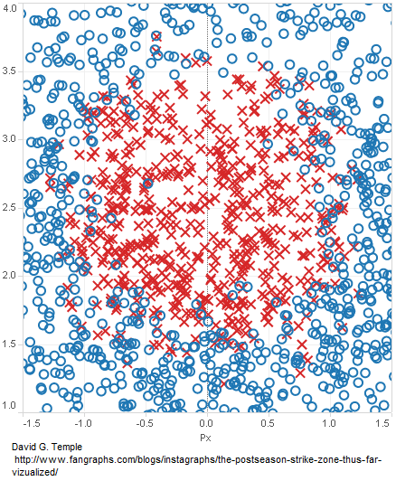
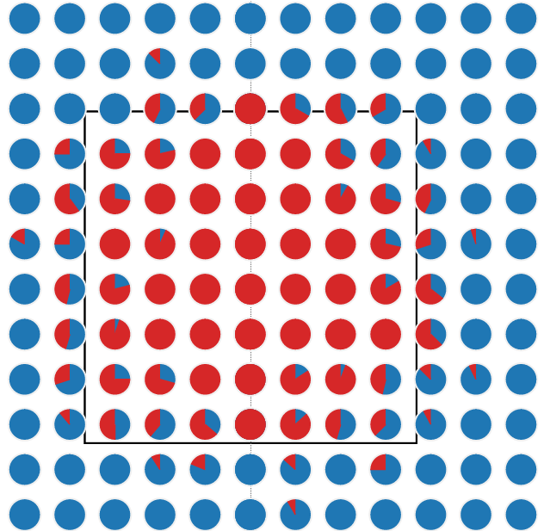
First Attempts Square Binning: Strike Zones
Original Fangraphs Article
Binned Pie-charts
My Final Remix

Slide 5
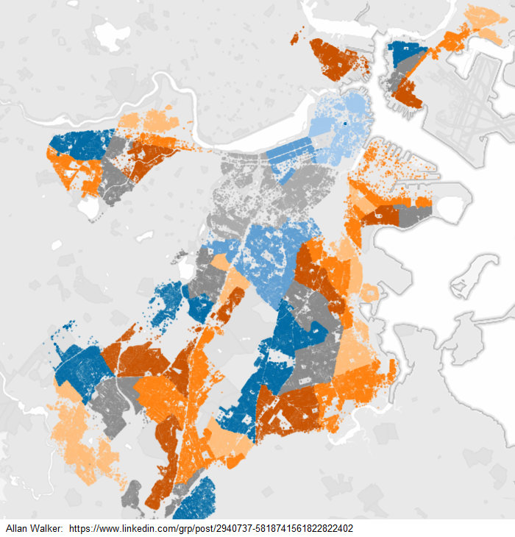
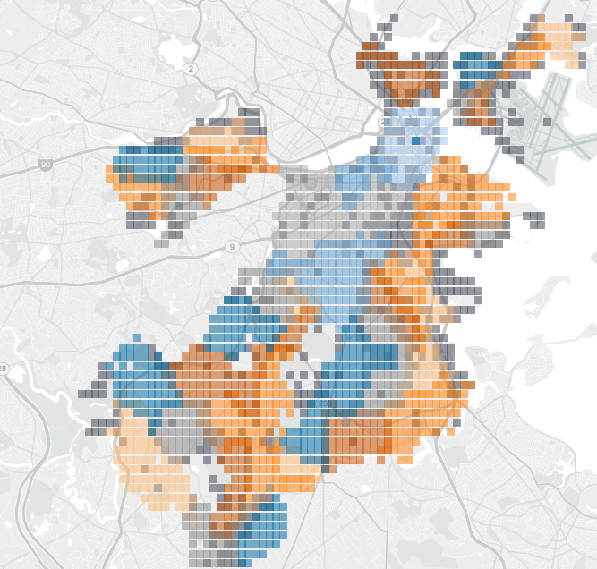
Example 2. Boston Trash Pickup
First time I loaded this, I got a memory error. Using a simple square binning, I went form a million + points to ~50,000

Slide 6
Tableau 9.0
In Tableau 9.0 there was a new unheralded new ability that I saw while just looking at the formula list in the Beta version.
HEXBINX(X,Y)
HEXBINY(X,Y)
This enabled a new type of binning that I could use called hex-binning
Need to scale the data to fit the Hexbins
When used on Tableau’s Mercator map projection, higher latitudes had more space between them.

Slide 7
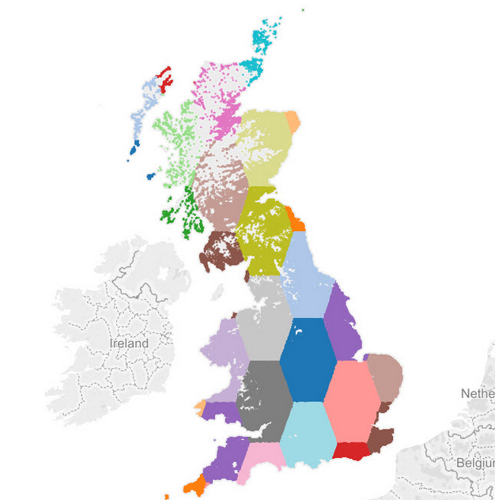
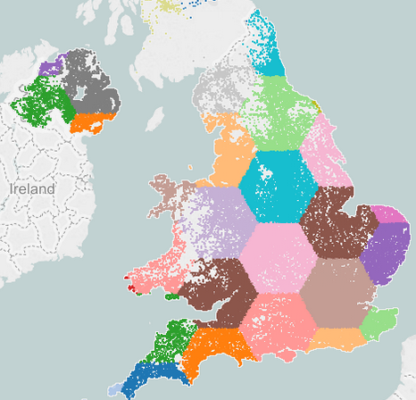
Hexagon Projections and Scaling
Chris Love did an excellent post on hexagon binning at higher latitudes

Slide 8
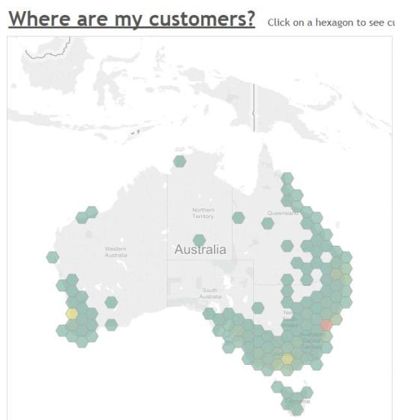
Alan Eldridge. Hex-polygons!
Alan was able to solve the previous problem by making polygons out of the hexbin functions.
Dense Hexagon fill no matter what the latitude!
Unfortunately it requires you to duplicate the data.
But… for a cost of x2 the data, Tableau draws a small fraction of the Marks.

Slide 9
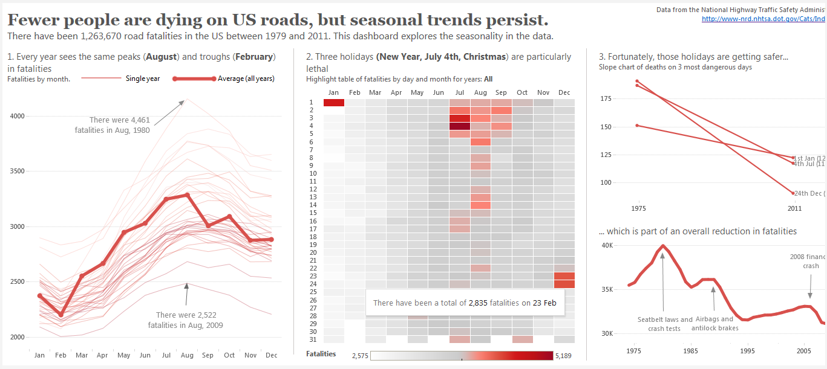
This dashboard by Andy Cotegreave inspired me to download accident location data

Slide 10
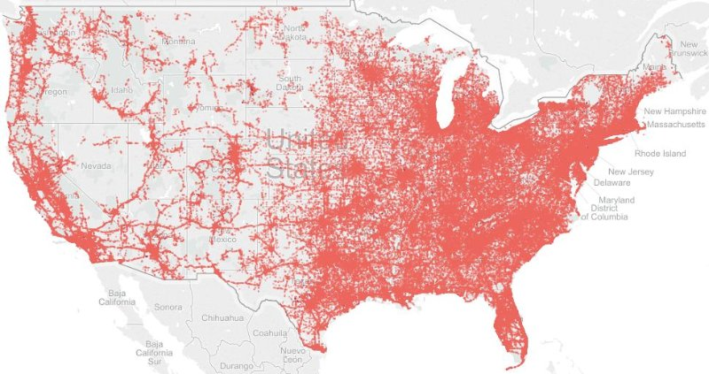
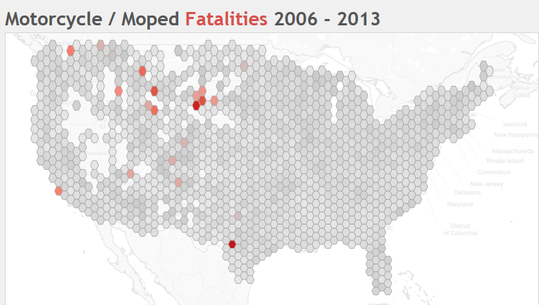
Fatal Accident Data Hex-binned
The map below represents ~7100 hexagons.
This point looks interesting
The chart above gave me frequent memory errors and was about 250,000 points.

Slide 11
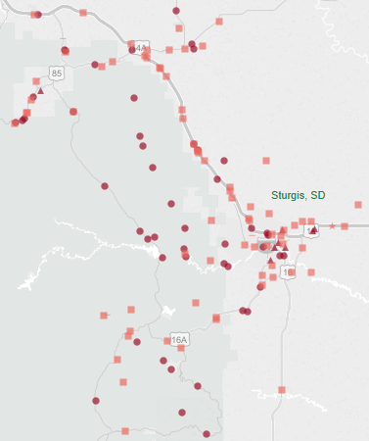
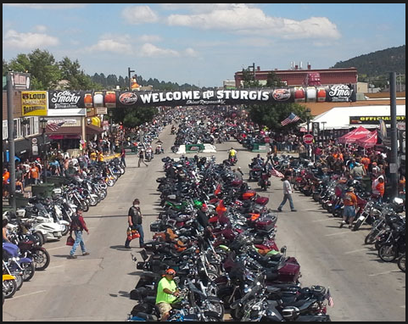
Hexbinning answers questions about an area!
With the hex-binned map, I was able to ask certain questions about specific areas. What immediately popped out to me was motorcycle deaths in a very rural part of the country.

Slide 12
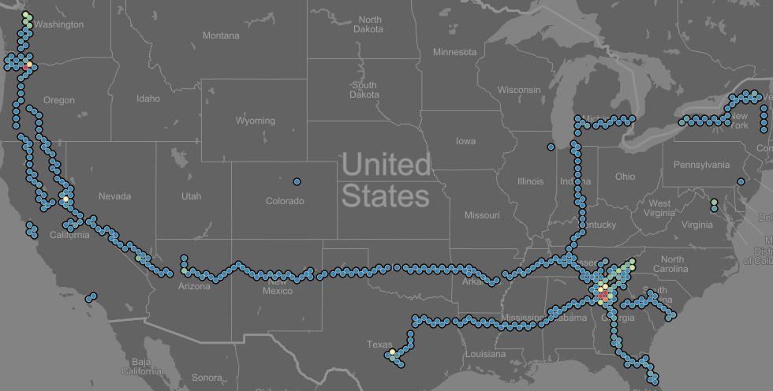
Questions about me…
Where have I been?

Slide 13
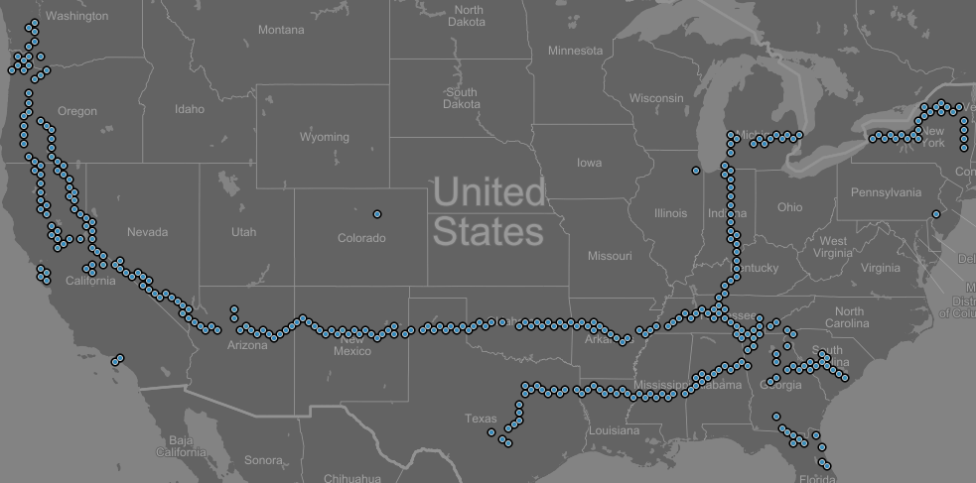
Places I’ve just passed through…
Places with 1-10 location records.
As you can see I’ve had several long drives!

Slide 14
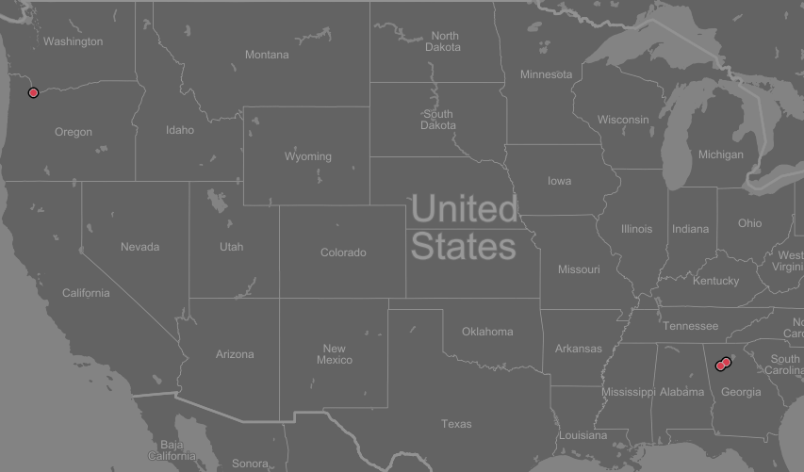
Where have I lived?
Hexes with more than 2000 location records.

Slide 15
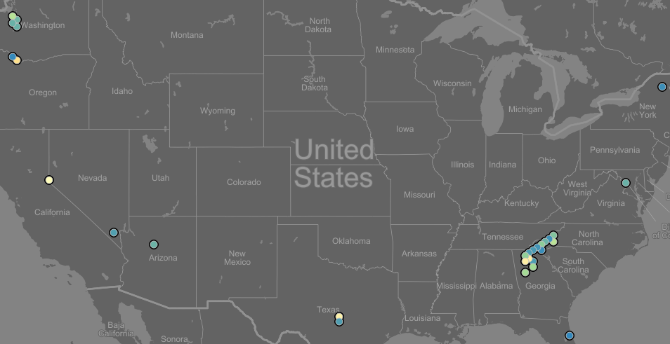
Some Vacations or trips I’ve had:
Hexagons with between 30 – 500 location points.

Slide 16
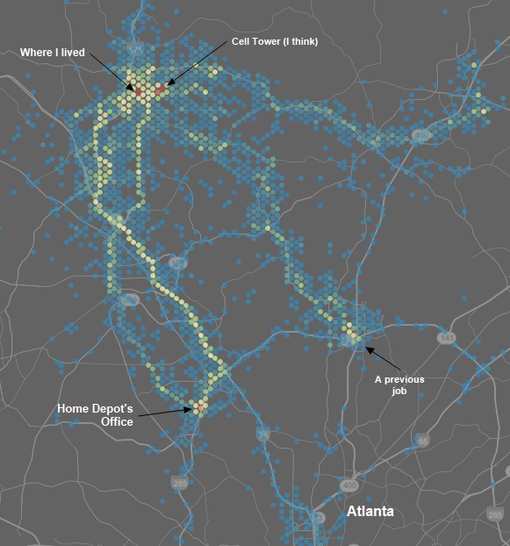
Atlanta
Various places I frequented in Atlanta. Home -> Work was a majority.
However even subtle things like the McDonalds or Bagel place I went to before church showed up easily.
Traffic lights I was stuck at showed up too.

Slide 17
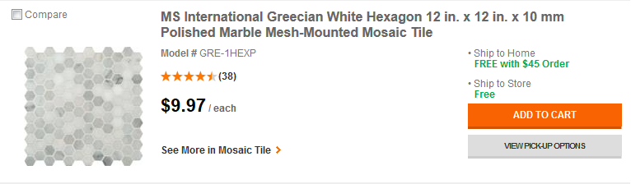
Home Depot Sells Hexagon Tile!
Home Depot .Com Tile

